Slide 1
It Starts With Us!
Using Coregulation To Support Students
The 2024 TAFE Queensland Virtual Summit for Educators
Presenter:
Jen Knoll
Notes:
This session will consider an understanding of how you can create an environment of safety, engagement and learning in your teaching sessions. This session will cover:
Regulation - including the impact of trauma on self regulation; and what this means for students. This includes a brief introduction to Polyvagal Theory and the Window of Tolerance to help understand safety and threat.
Co-regulation or relational regulation, what you can offer students.
Classroom strategies - including body focussed activities, reliable relationships, safe ways for expression, repair and rupture, and how we can deepen belonging and connection.

Slide 3
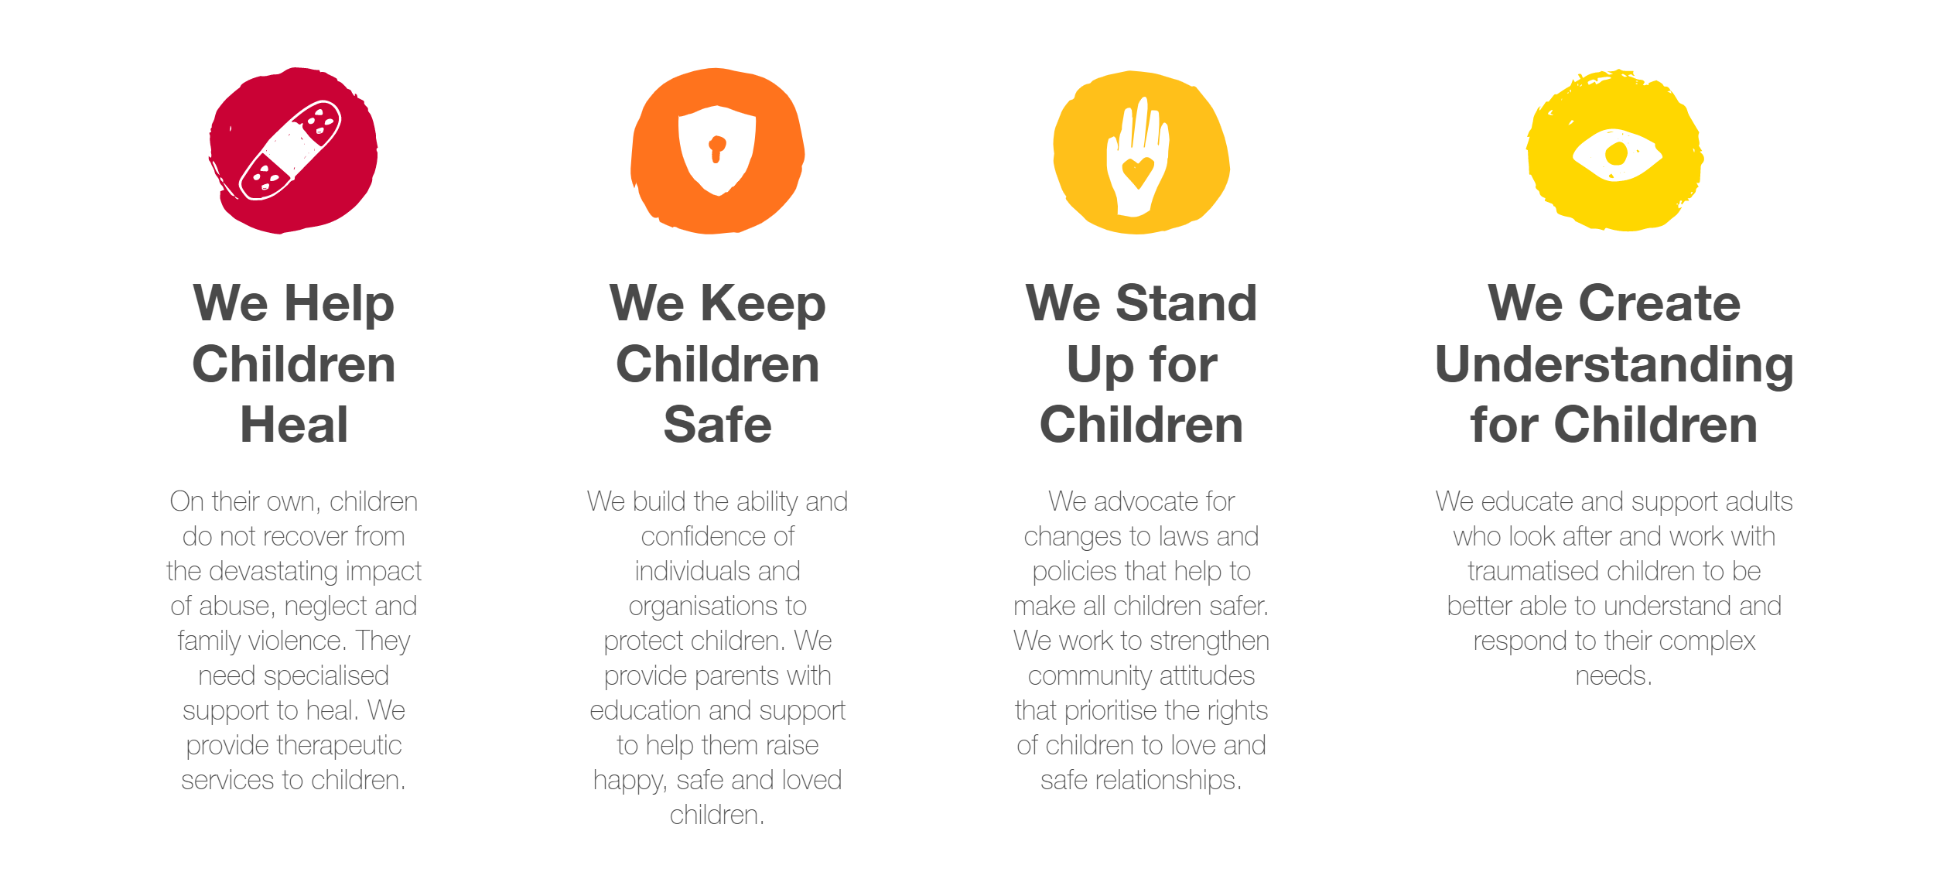
The Australian Childhood Foundation

Slide 4
Our Education Services
Our Education Services co-create and amplify knowledge that changes children’s lives for the better, by creating networks of learning in partnership with professionals and organisations working with children and young people.
Our efforts include:
Accessible learning opportunities for professionals: a range of self-paced modules and virtual classrooms covering trauma prevention, relational healing and evidence-based approaches to best practice.
Customised organisational education: tailored training packages designed to support ongoing staff development, including Train The Trainer options for long-term success.
Accredited training: our unique Graduate Certificate in Developmental Trauma
Access our latest offerings:
https://professionals.childhood.org.au/training-development/

Slide 5
Our Safeguarding Services
Over a decade, Safeguarding Services have partnered with over 300 organisations nationally and internationally to strengthen the capacity of institutions to keep children and young people safe.
We offer a suite of standard and customised solutions that meet national and state Child Safe Standards, aimed at creating organisational culture change.
We draw on best practice from the Foundation’s experience and our network of partners, and evidence, including our recent Safeguarding Evaluation by the Centre for Social Impact.
Accreditation
Certification
Training
Bespoke Services
Access our latest offerings:
https://professionals.childhood.org.au/safeguarding-children-services

Slide 6
Safety
Our experience of safety is so intertwined with the physiological state of others with whom we relate. It is therefore a survival imperative that we are able identify people who are safe or who represent a threat to us.
Notes:
Safety is perceived psychologically and experienced physiologically.
Safety incorporated into all school relationships as a source of both physiological and psychological regulation facilitates developmental growth and restoration.
“To fulfill our biological imperative of connectedness, our personal agenda needs to be directed towards making individuals feel safe.” (Porges, 2011)
The wasy we understand safety is through Regulation theory- the presence of safety- regulation the lack of safety –dysregulation

Slide 7
Relational Safety

Slide 8
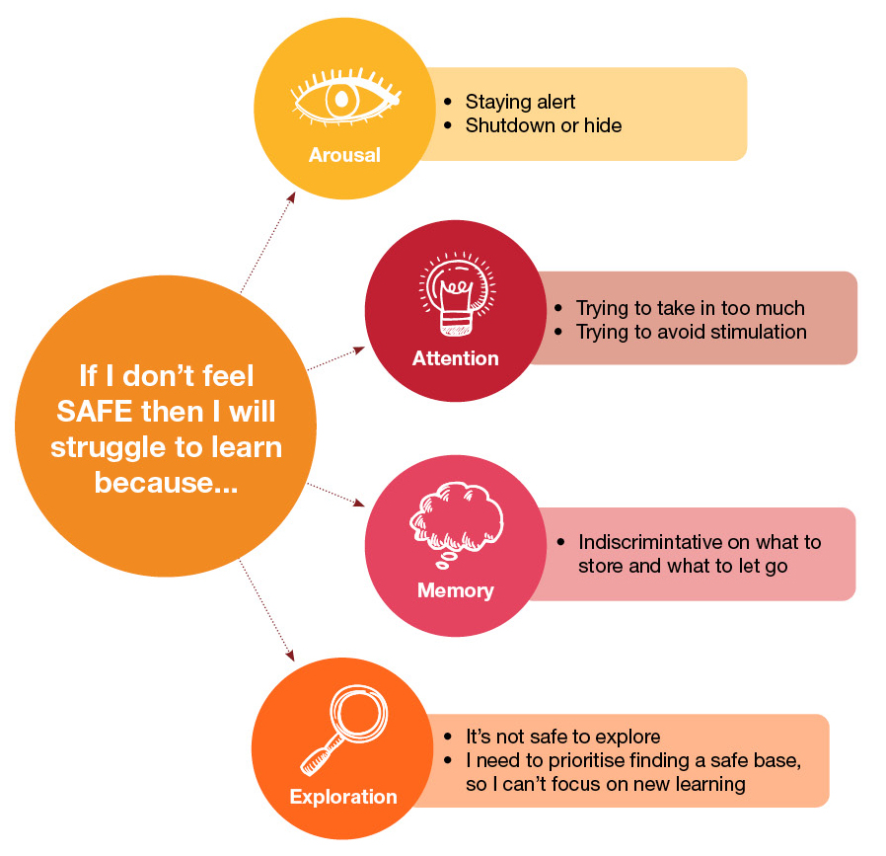
The ability to engage and learn requires Safety.

Slide 9
What is Regulation?
Regulation refers to the process your brain goes through to determine whether you are safe or not and then it’s ability to adjust how calm or alert you are.
If we consider domains of regulation these could include:
Physiological
Emotional
Relational
Cognitive
Notes:
Physiological: Regulation is about being connected to our physiological state in an integrated way that makes sense to us.
Emotional Dan Seigel states The minds ability to regulate emotional processes is essentially the ability of the brain to modulate the flow of arousal and activation throughout its circuits.
Relational: as Dan Seigel states: how we experience the world, relate to others, and find meaning in life are dependent upon how we have come to regulate our physical state and emotions.
Cognitive: as we mentioned previously in order to learn we need to be in a space where our mind and body feels safe in order to engage, learn, store information and explore concepts. We also know that the left side of the brain where our focus on language, reading and writing is a key focus, exhausts children without the necessary balance of right-side relational, play-based creative experiences. You may have utilised brain breaks in your practice already as a way of re-engaging students.

Slide 10
What is Self Regulation?
Self regulation is the ability to monitor and control our own behaviour, emotions, or thoughts, altering them in accordance with the demands of the situation (J.Cook, 2014).
Self regulation, however, is not a destination (Dana, 2019).
Daily experiences will see us move in and out of a calm and regulated state. A significant strategy for providing self regulation is co-regulation (warm, responsive interactions with others that provide emotional support is essential).
Nurturing collegial relationships where co-regulation can exist is a strong antidote to stress (Badenoch, 2018).
Notes:
The ability to tolerate sensations, situations and distress, and form appropriate responses. CONTINOUS MOVEMENT OF OFFERINGS FROM RELATIONSHIP. How do teachers monitor, hold, noticing,
The importance of self-regulation is most readily observed in the consequences of its absence…
Skill-based construct – skills, abilities, capacities
Includes skills such as:
Being able to inhibit first responses
Resist interference from irrelevant stimuli
Persist with necessary tasks even when we don’t enjoy them
Trauma sensitive schools checklist defn: “A trauma-sensitive school is a safe and respectful environment that enables students to build caring relationships with adults and peers, self-regulate their emotions and behaviours, and succeed academically, while supporting their physical health and well-being.”
(Lesley University Centre for Special Education, and the Trauma and Learning Policy Initiative of Massachusetts Advocates for Children, and the Legal Services Centre of Harvard Law School).

Slide 11
What is Dysregulation?
Trauma is a violation of relational safety that changes the way the child’s brain and body functions. It reshapes a child’s developing physiology and psychology through experiences of terror and a lack of safety.
A child’s narrative and identity is filled with fears of rejection, isolation and shame.
Children must find ways to keep themselves safe based upon survival that might present in relational behavior's that are difficult to understand. It is a child’s search for comfort and attempt to seek safety.
A child is forced to become preoccupied in ensuring their own safety. Impacting in their capacity to attend to task, listen, recall and analyse information.
Notes:
(Previous Slide 12)
The discussion around dysregulation is an important one in terms of its reframe and how we consider how it has become terminology that decontextualises a child
Dysregulation is a child using protective mechanisms to help them to cope under duress. It has become understood and viewed as “behaviour’ in children ie a child is responsible for becoming regulated and then they can exhibit self regulatory states independently. There are many ways that we respond to and manage behaviours that does not consider the frame we are discussing today
It is the impact of their past experiences unique to them
It reflects the reasons for the behaviour and the narrative that becomes reinforced
Self reliant adaptive states emerge as ways of attempting to establish safety when this is not available. Dysregulation is experienced in these states but it is not a choice or deliberate behaviour
Dysregulation is the search for comfort, the attempt to seek safety
It is the impact of their past experiences unique to them
It reflects the reasons for the behaviour and the narrative that becomes reinforced
Self reliant adaptive states emerge as ways of attempting to establish safety when this is not available. Dysregulation is experienced in these states but it is not a choice or deliberate behaviour
Physiologigal
Relational
Emotional
Cognitive

Slide 12
Creating Understanding
Two explanatory frameworks utilised to help us understand, monitor and respond to regulatory states are:
Polyvagal theory
Window of tolerance
These provide an understanding of the physiology that gives rise to states of safety and states of threat and how we transition from one to the other.
For some children being ready to shift states rapidly into action is how they have adapted to seek safety.
Notes:
As a child begins to experience safety within their relationships a space is opened up where the childs unmet relational needs originating in the past can re emerge and be seen and ackonowledged
The childs self reliant adaptive states previously used to seek safety become less necessary. Ie I don’t need to run away or shut down
They learn that they can experience safety whilst exploring old unmet needs in a shared relational space
“someone has arrived who can accept and tend to my needs”

Slide 13
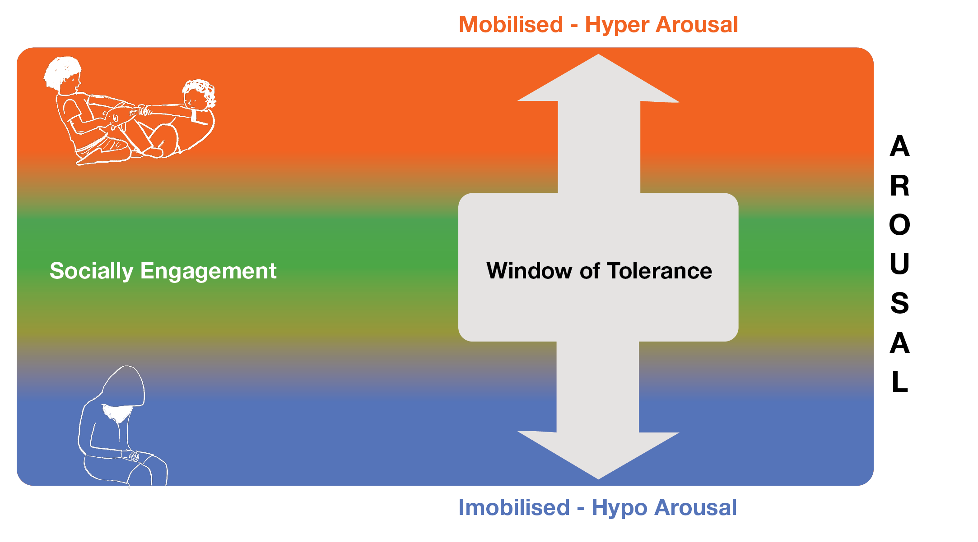
Window of Tolerance
A resource for:
Understanding how regulation states present for a child.
Monitoring: mapping the child’s states across the day/ week.
Response: Understanding what is helpful to bring comfort to the child.

Slide 14
What is Co-regulation?
Co-regulation is a relational regulation with an offer of safety
It involves:
A collaborative process that involves attunement, empathy, and active listening. By working together to regulate emotions and behaviours, individuals can build stronger connections and promote overall well-being.
Growth and development: children can gradually take on more responsibility for their own regulation, with the support of caregivers and other adults.
Involves a physiological connection that involves the sharing of oxytocin and the soothing of the stress hormone cortisol.

Slide 15
Co-regulation- a relational offering
Relational offering:
An orientation – I’m going to be open. Adaptive, understand this unique relationship with the child.
Presence – showing up, heard, met, felt and understood.
Curiosity and empathy about the meaning of the child’s story.
Provide understanding and meet the child’s need.
Develop classroom relational rituals, Participating in these rituals can help educators build and maintain connection with the students
Playfulness, Acceptance, Curiosity and Empathy PACE Framework Dan Hughes
Notes:
As a child begins to experience safety within their relationships a space is opened up where the childs unmet relational needs originating in the past can re emerge and be seen and ackonowledged
The childs self reliant adaptive states previously used to seek safety become less necessary. Ie I don’t need to run away or shut down
They learn that they can experience safety whilst exploring old unmet needs in a shared relational space
“someone has arrived who can accept and tend to my needs”
Re the concept of repair these are the things I generally say
I would put this in somewhere around your discussion of relational co/ regulation
Repair is an opening which enables a child to feel pleasure trust security. It provides an implicit belief and knowledge that problems can be overcome. It enables anticipation and a sense that cycles of repair are parallel and reciprocal
“ a teacher knows how to bring us back together”

Slide 16
Rupture and Repair
Repair and rupture are intrinsic to all relationships. Repair is an opening which enables a child to feel pleasure, trust and security. It provides an implicit belief and knowledge that problems can be overcome. Repair enables anticipation and makes transition possible.
Build in opportunities for 1:1 time to connect with children.
Consider an additional relationship or emotional anchor that is available to children when issues arise.
Provide social stories of ways in which ruptures and repairs happen in your classroom.
Initiate timely repair.
Find ways to reconnect with the child through play, art, creation, relational activities.
“Someone who cares for me knows how to bring us back together”
Notes:
What I also say in referencing Tronick and repair
Transition and change for children is “being asked to go from something well put together to something different”
link between change/ transition and relational rupture is really important
Children who have experienced trauma are well organised in their adaptions. Change requires them to dismantle their systems of organisation. They have to take apart something that is familiar, not knowing what the change will mean- what they are changing to. This is an experience of mess stress and disorganisation for a child
What we see is their attempt to survive this through states that can cause rupture in relationships
Repair is an experience that children can anticipate and rely upon when rupture becomes part of these change processes for children
- - -
- Repair is an opening which enables a child to feel pleasure trust and security. It provides an implicit belief and knowledge that problems can be overcome. Repair enables anticipationAll relationships experience instances of rupture. For children who have often had stressful relational experiences, it is a healing imperative that they witness an adult recognise the significance of repairing those ruptures on their behalf. Ed tronick provides more knowledge on the healing of rupture and repair.
- Repair models experiences of relational mismatch transforming into positive feelings when people achieve a match
Ie: principal comes to take over class and takes child out and do repair with them.
Ie: utilising support staff to support large group time, as you facilitate individual connection times with students.

Slide 17
The Importance of You
“ As committed and caring professionals, we put the needs of our students at the fore of all we do and regularly support colleagues who may need help,
but how often do we take time to meet our own needs?”
Being mindful of your emotional and physical state.
Understanding the influence of your own story.
Know your stress points
Having a range of self-care strategies that are planned and practiced
Ensuring wellbeing strategies such as sleep, nutrition.
Nurturing supportive collegial relationships.
Stephenson, E (2021) Please secure you own mask first, Teaching in Action, Issue #2 2021, Australian Council for Education Leaders, NSW

Slide 18
